Slide 1

IoT-Driven Smart Traffic Management System for Urban Congestion Reduction
ELC Project Summer 2025
Under Mentorship of Dr. Amit Kumar Trivedi
Presented by Group-10
Anchit Mehra 102203810
Ayush Sharma 102203840
Samdeep Sharma 102217183
Smarth Kaushal 102497023
Aniket Gupta 102317169
Pavni Goel 102304043

Slide 2

PROPOSED SYSTEM
Group No.10
Predict. Optimize. Move Smarter.
Core Modules:
Data Pipeline – Real-time traffic data from IoT/simulations ➜ CSVs
ML Prediction – XGBoost model forecasts traffic using cleaned, scaled data
Signal Optimization (Future) – Adjust signals dynamically
Visualization – Live Streamlit dashboard with trends & camera frames
How It Solves the Problem
Predictive signal control ➜ less congestion.
Reduced wait time ➜ optimized junction flow.
Automated, near real-time pipeline.
Self-improving with adaptive learning
Innovation & Strengths
ML Pipeline: Outlier handling + Scaling + XGBoost
Modular Design: Easy to upgrade or scale
Streamlit Dashboard: Real-time + history + auto-refresh
Evaluation: MAE, RMSE, R² built-in
Real-time | Predictive | Scalable | Adaptive

Slide 3



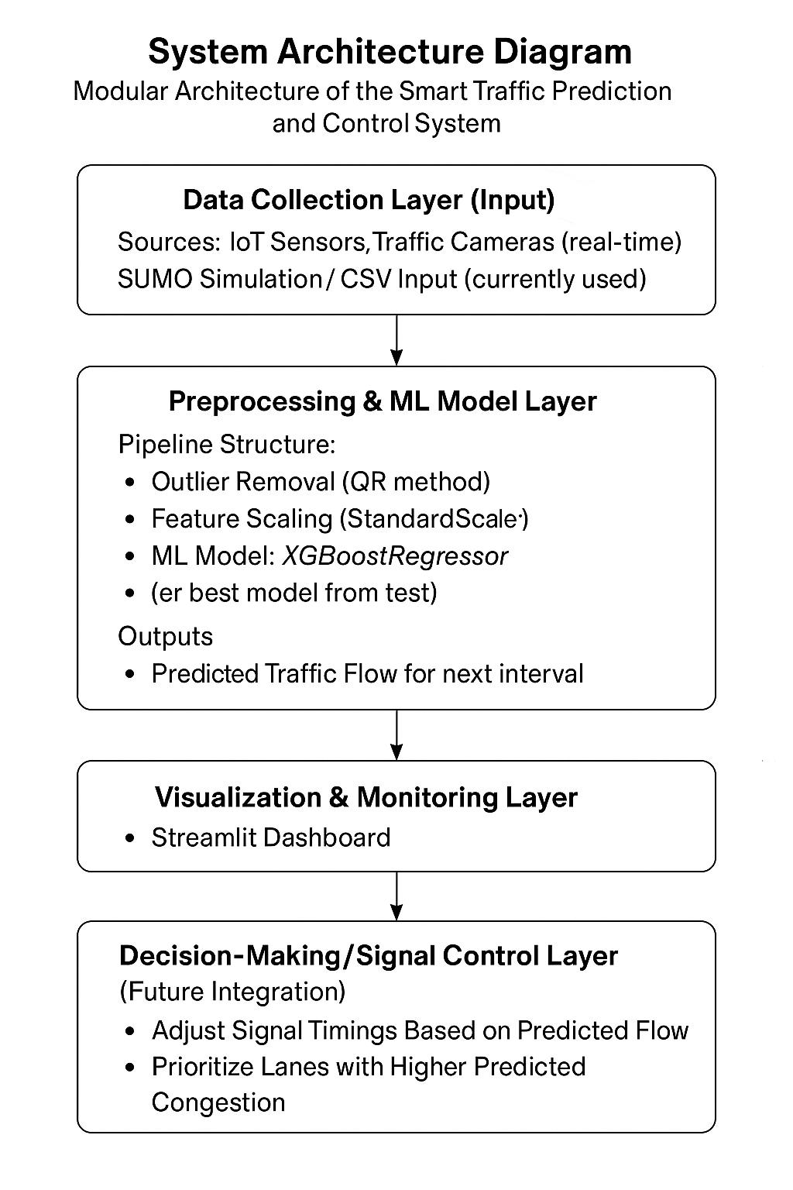
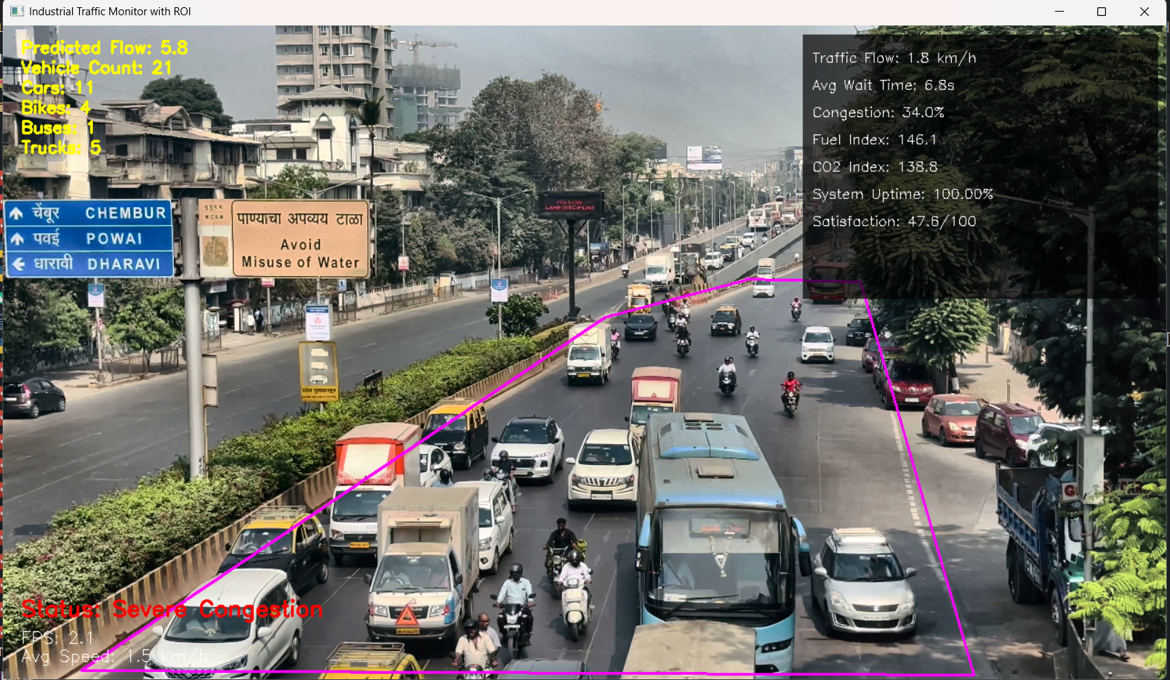

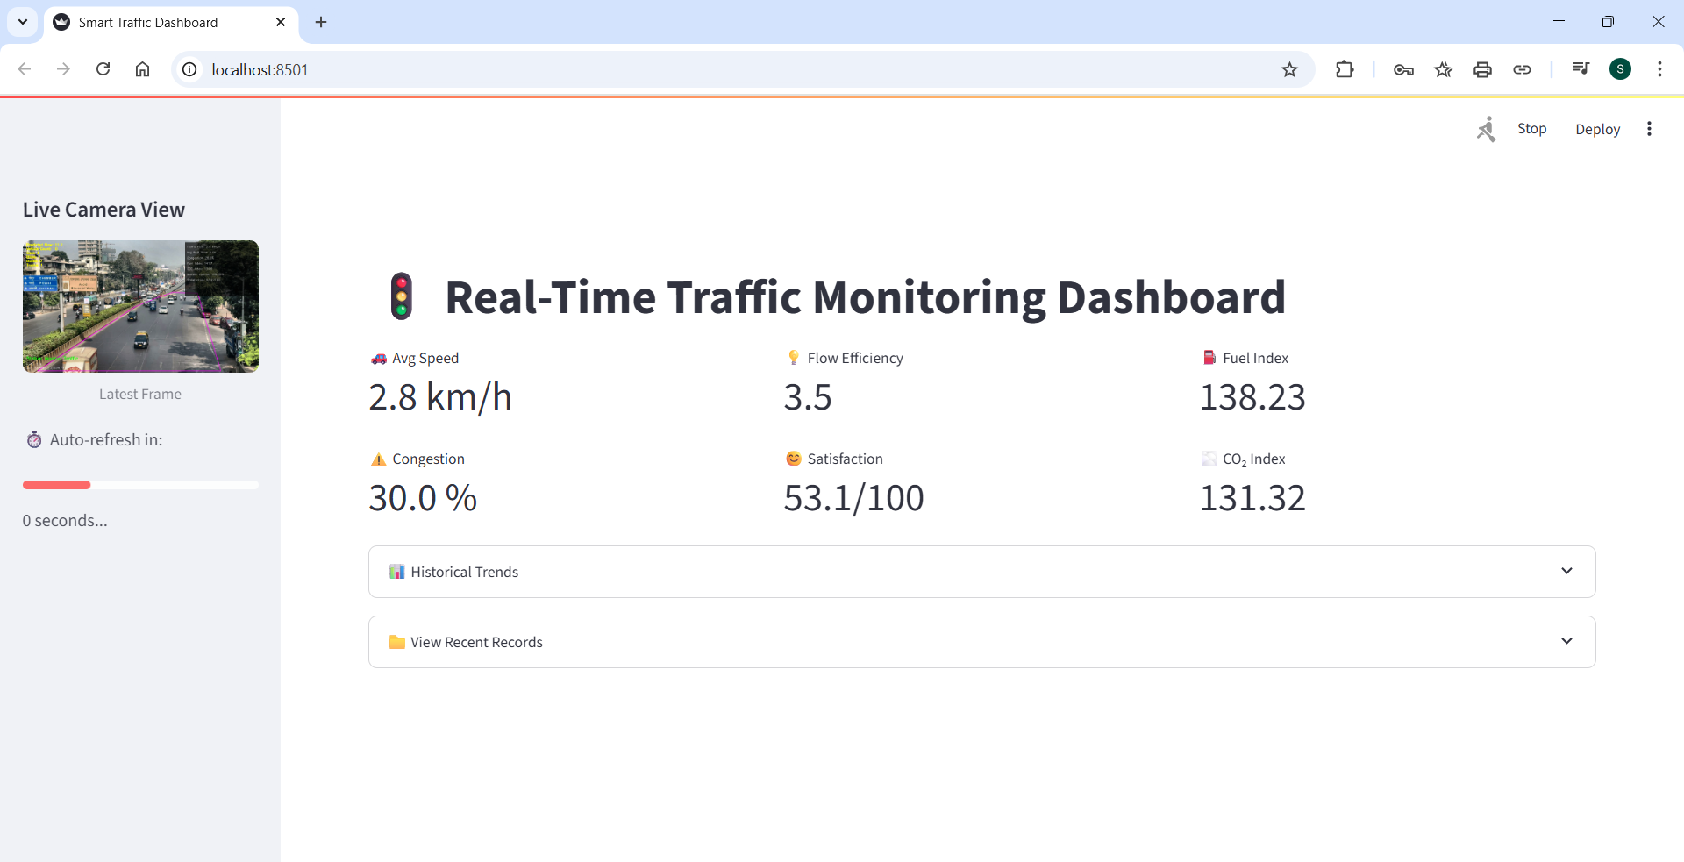
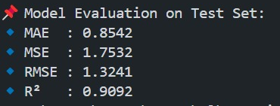
SYSTEM ARCHITECTURE AND TECHNICAL WORKFLOW
Group No.10
VIDEO
FEED
VEHICLE DETECTION
FRAME GRABBER
CONGESTION
LEVEL
KPI METRICS
Real-time Streamlit Dashboard displaying live traffic metrics, trends, and camera feed.

Slide 4
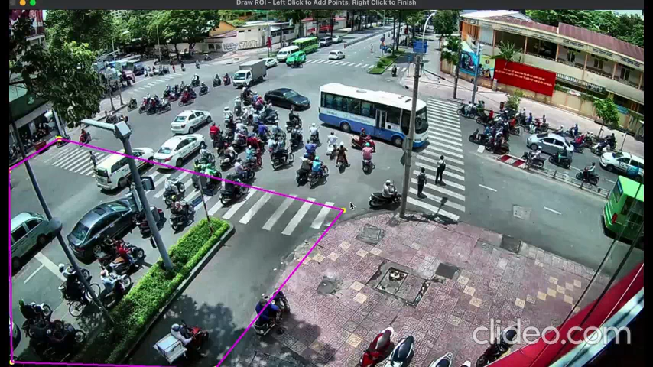
PROOF OF WORK
Group No.10

